Slide 1
Supplement to Lecture XII: Cosmic Microwave Background (Planck-centric since this is current)

Slide 2
Contents
How to use CMB anisotropies to measure cosmology
Observational aspects

Slide 3
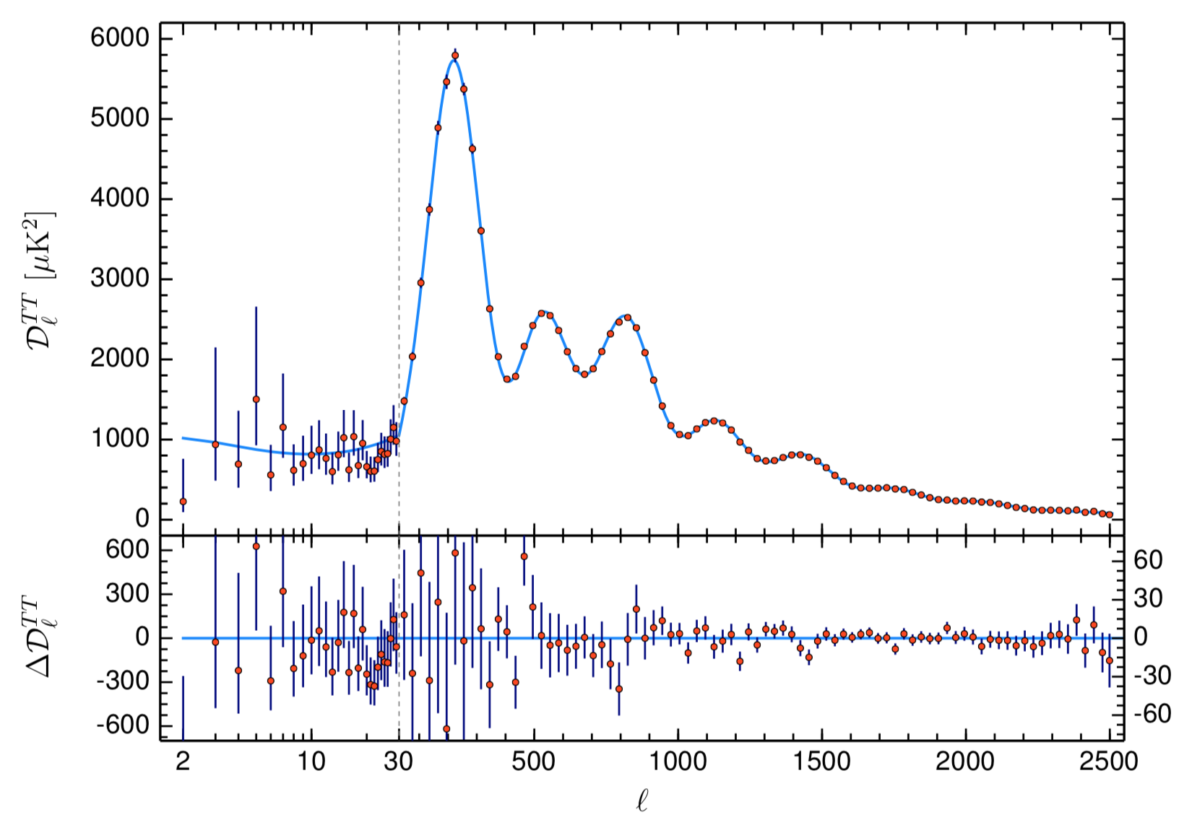
CMB power spectrum measured
by Planck
(Planck 2018 VI)

Slide 4
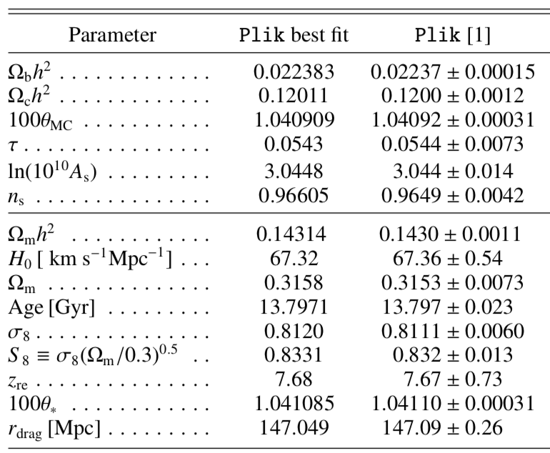
Planck 2018 Cosmological Parameters (ΛCDM model, fit with temperature + polarization + lensing of CMB)

Slide 5
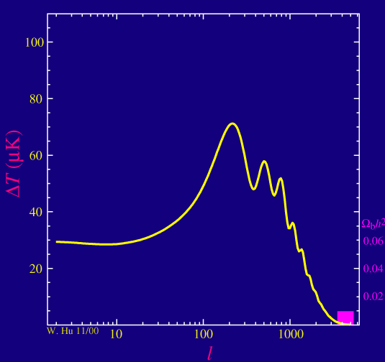
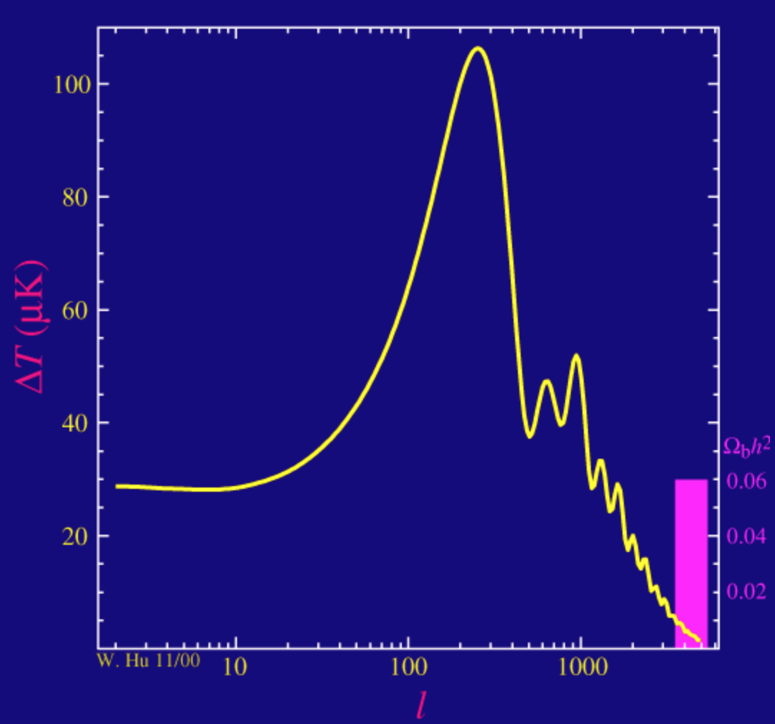
What’s underneath the χ² fit
pictures from Wayne Hu’s CMB tutorial – http://background.uchicago.edu/~whu/intermediate/
Low Ω_{b}h²
High Ω_{b}h²
Weak odd-even effect in peaks Strong odd-even effect in peaks

Slide 6
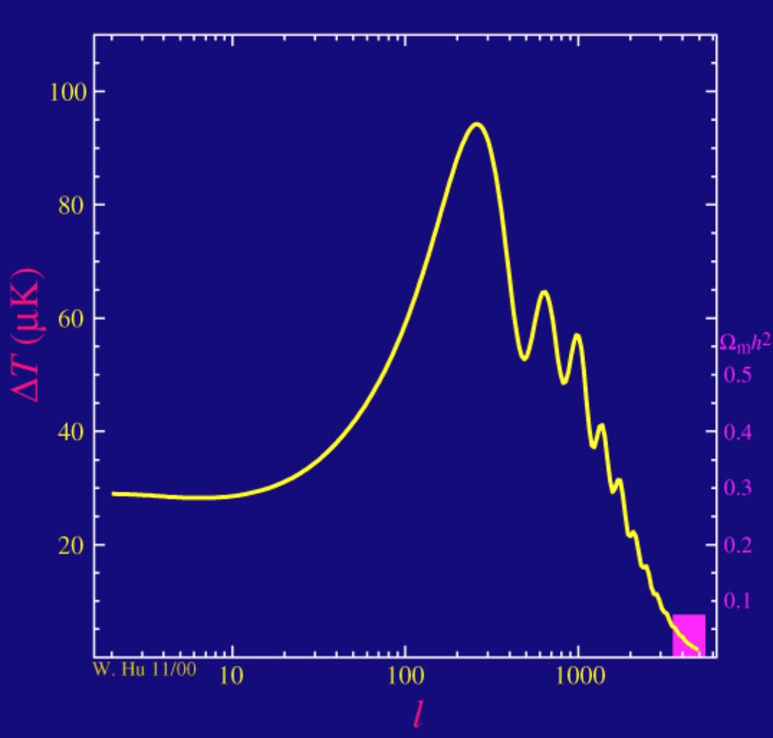
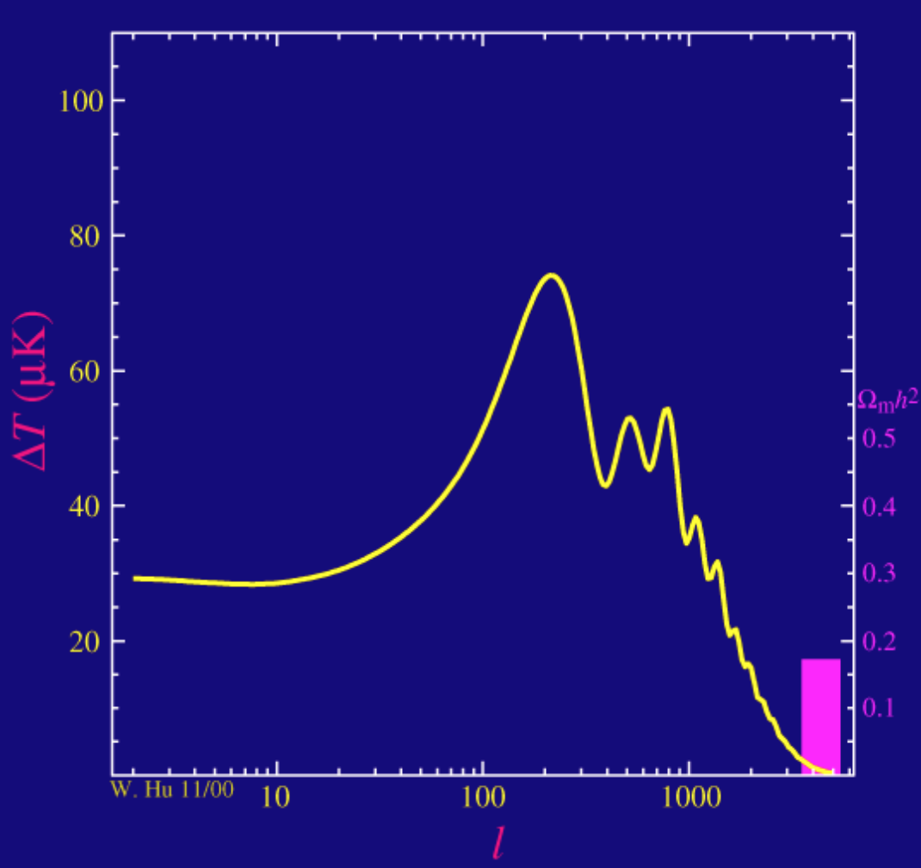
What’s underneath the χ² fit
pictures from Wayne Hu’s CMB tutorial – http://background.uchicago.edu/~whu/intermediate/
Low Ω_{m}h²
High Ω_{m}h²
Small 3rd:1st peak ratio Large 3rd:1st peak ratio

Slide 7
CMB peak position

Slide 8
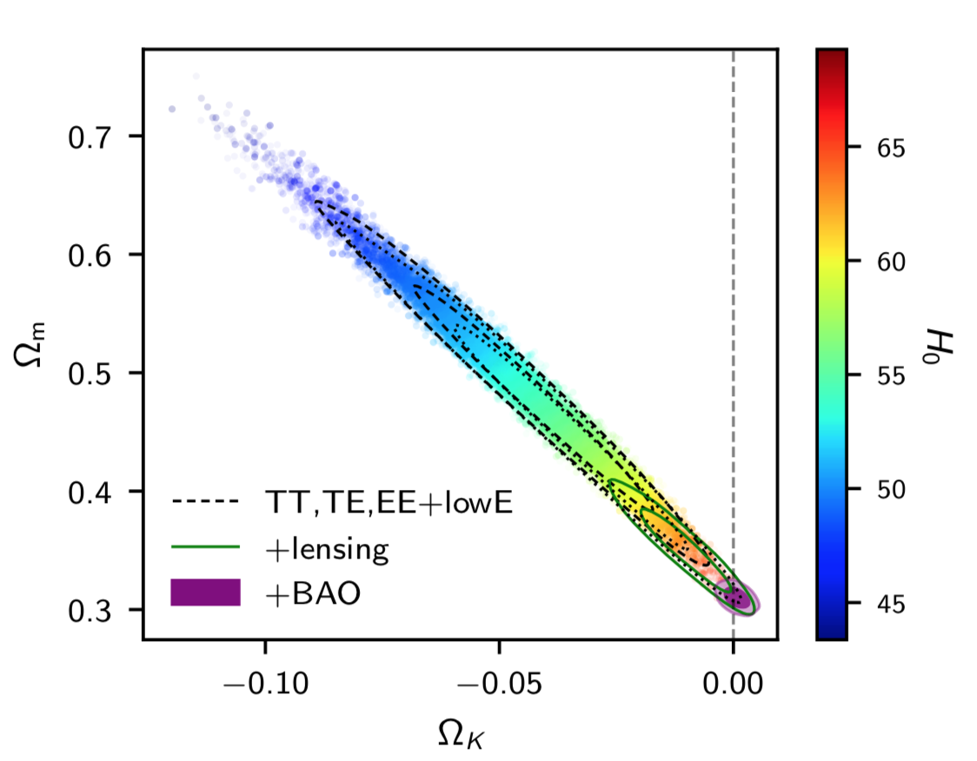
Parameters from CMB anisotropies
Planck 2018 I
Peak structure → Ω_{b}h², Ω_{m}h²
Broadband → A_{s}, n_{s}
Peak position → r_{LSS} (z=1100)
In ΛCDM, this gives expansion history of the Universe since there is 1 unknown (Ω_{Λ}h²) that is constrained by r_{LSS}.
H₀ is a derived quantity since Ω_{b}h² + Ω_{m}h² + Ω_{Λ}h² = h².
In extended models (e.g. ΛCDM + curvature), need more information.

Slide 9
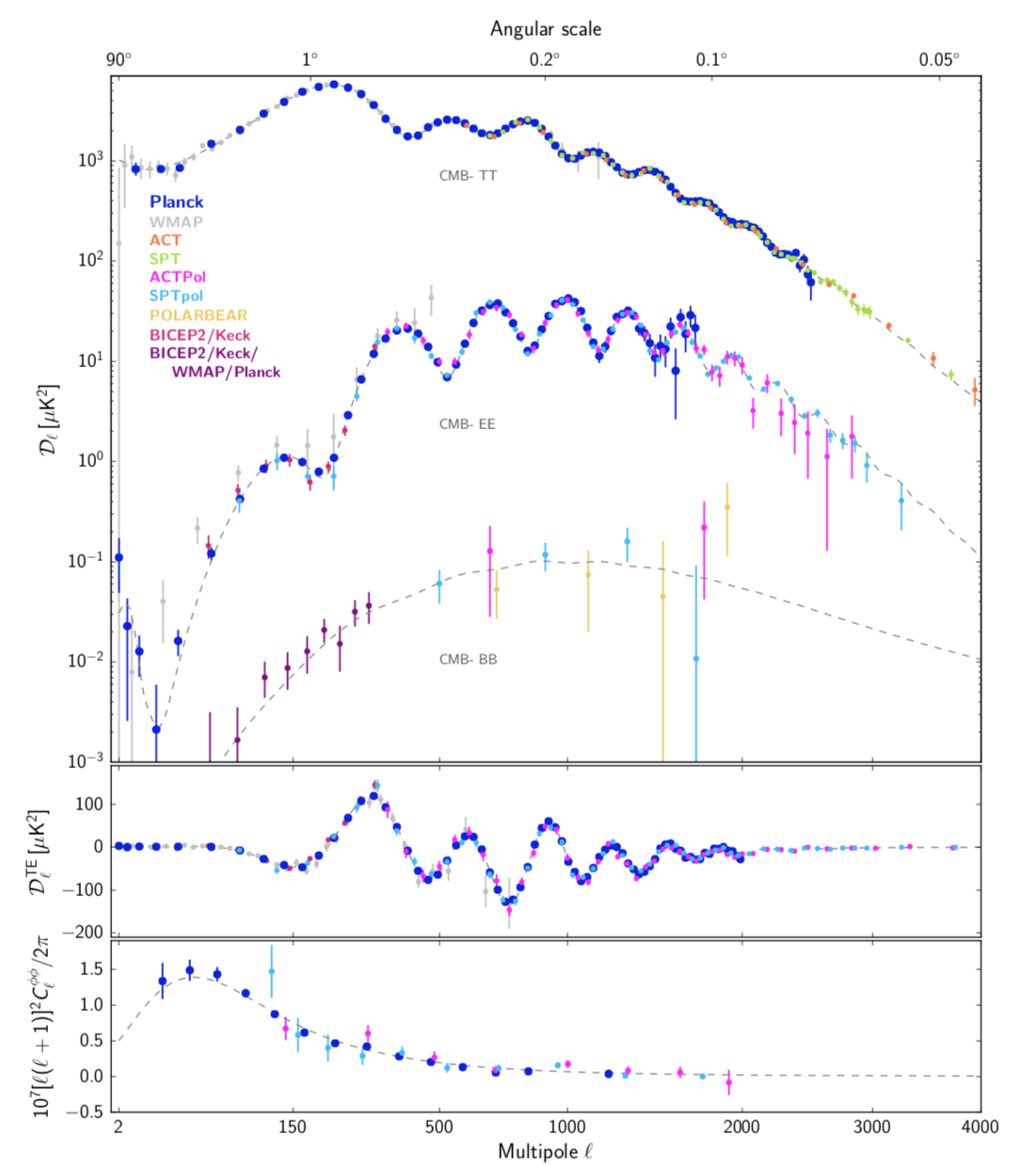
100 µK rms
Including polarization
(Planck 2018 I)
10 µK rms
1 µK rms
(reionization)
100 nK rms
(lensing)

Slide 10
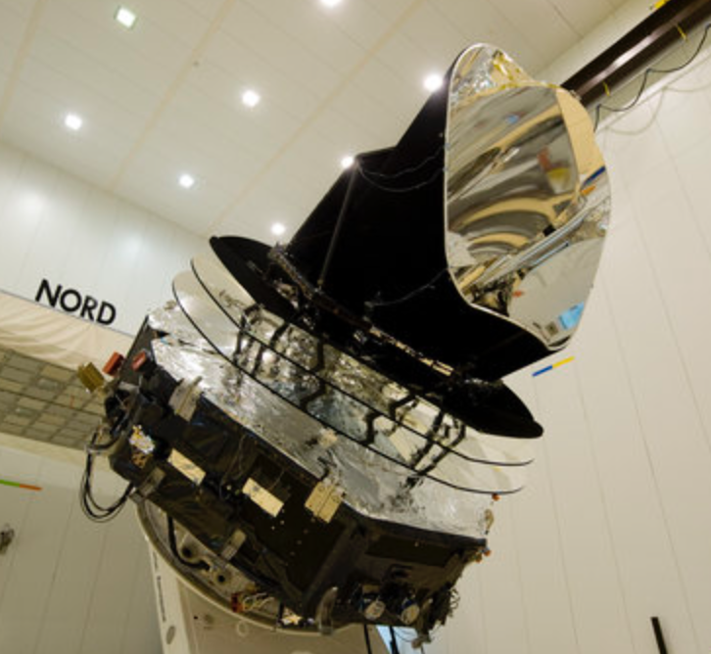
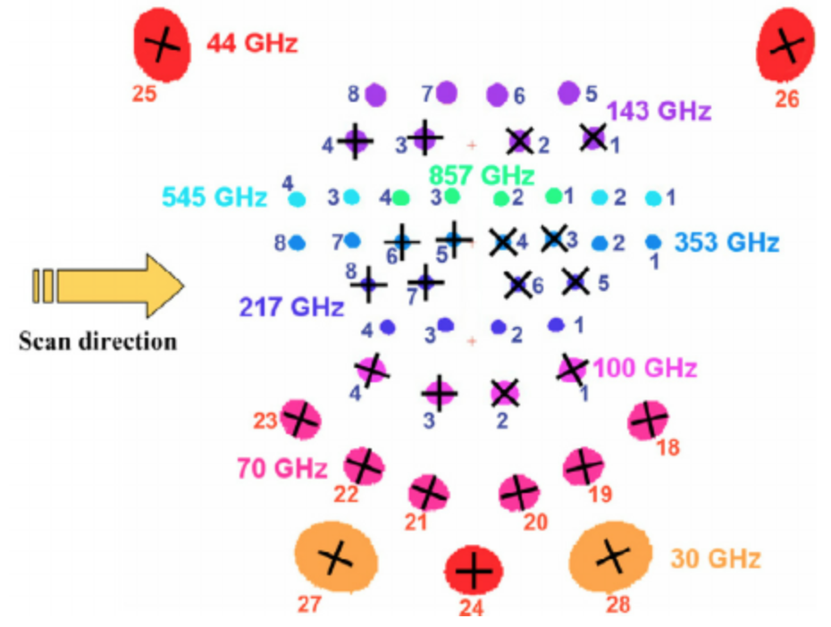
Planck – launched 2009
Focal plane layout
(Planck early results XIV)
“+” indicates polarized detectors
Planck at launch site
(ESA)

Slide 11
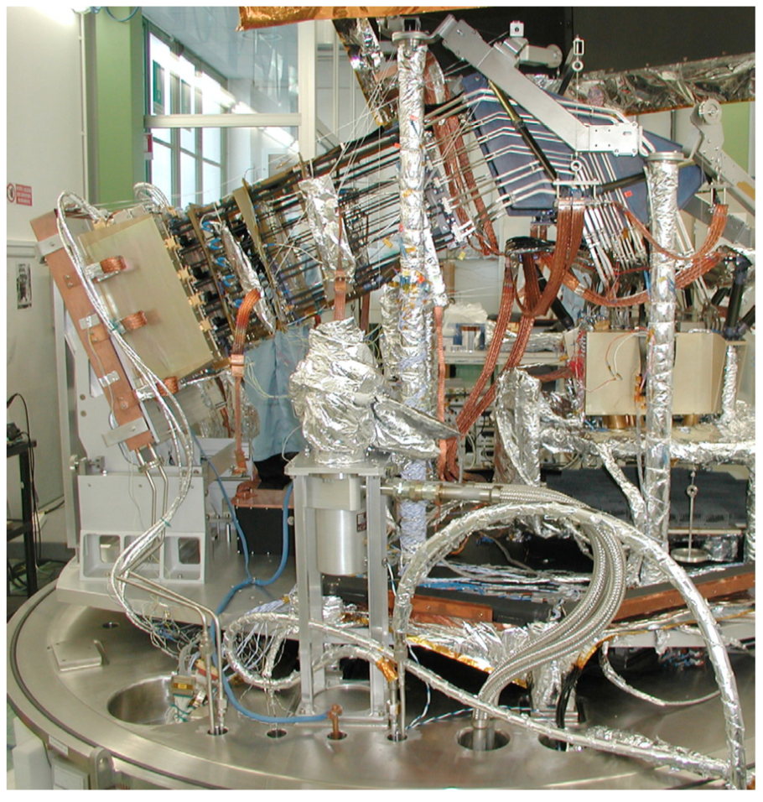
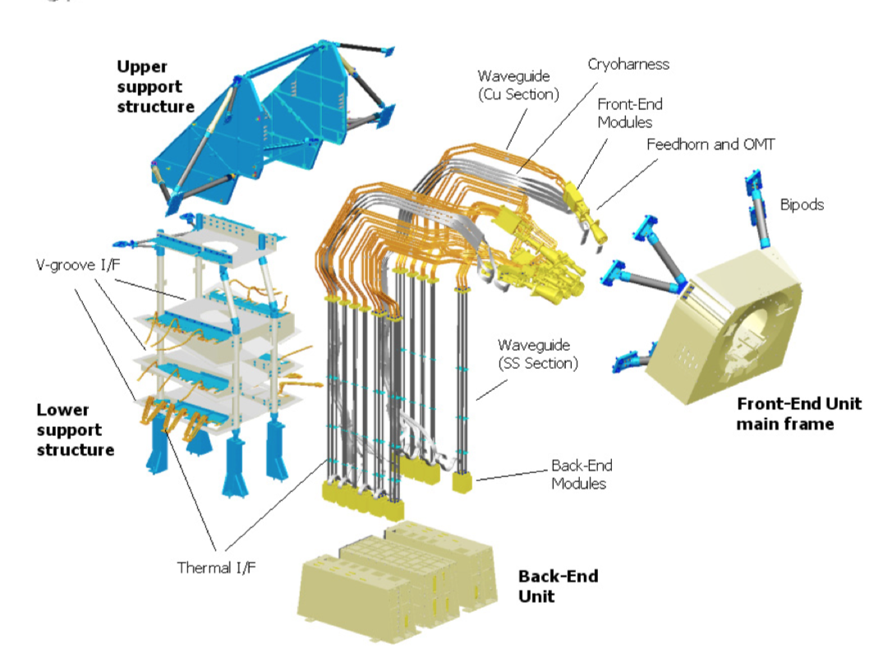
Low Frequency Instrument
Bersanelli et al., A&A 520, A4 (2010)

Slide 12
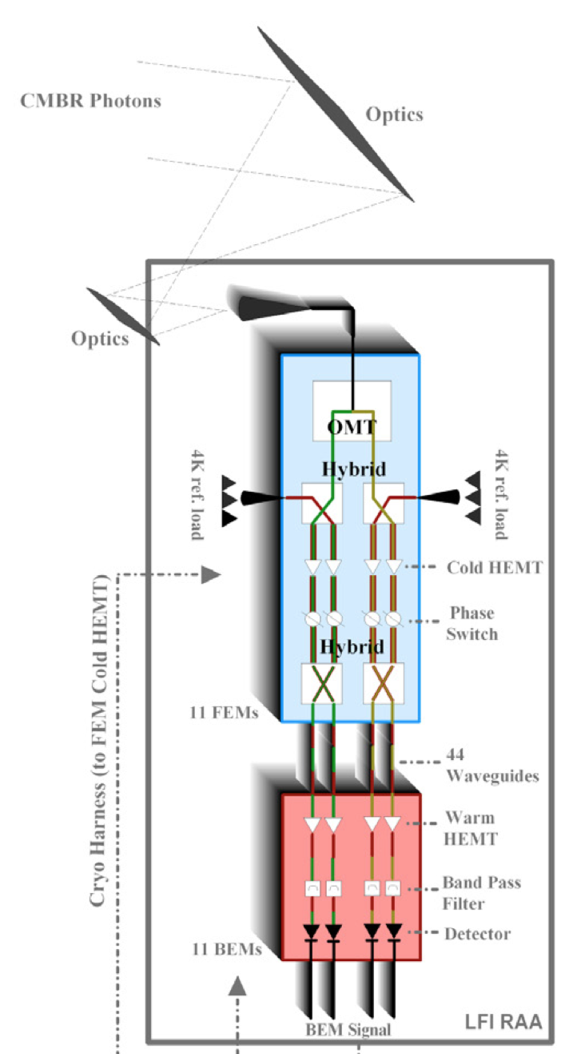
High electron mobility transistor
amplifier technology
(WMAP, Planck Low Frequency Instrument)
Signals are coherently amplified (sense voltage, not total power)
Hybrid couplers A, B → (A±B)/√2 used twice for robustness against cold amplifier gain fluctuations
Phase switch to rapidly swap which output is signal and which is reference
Reference may be internal load (Planck) or another patch of CMB sky (WMAP)
“Cold” amplifiers = tens of Kelvin
Amplifiers harder as you increase frequency!
Bersanelli et al., A&A 520, A4 (2010)

Slide 13
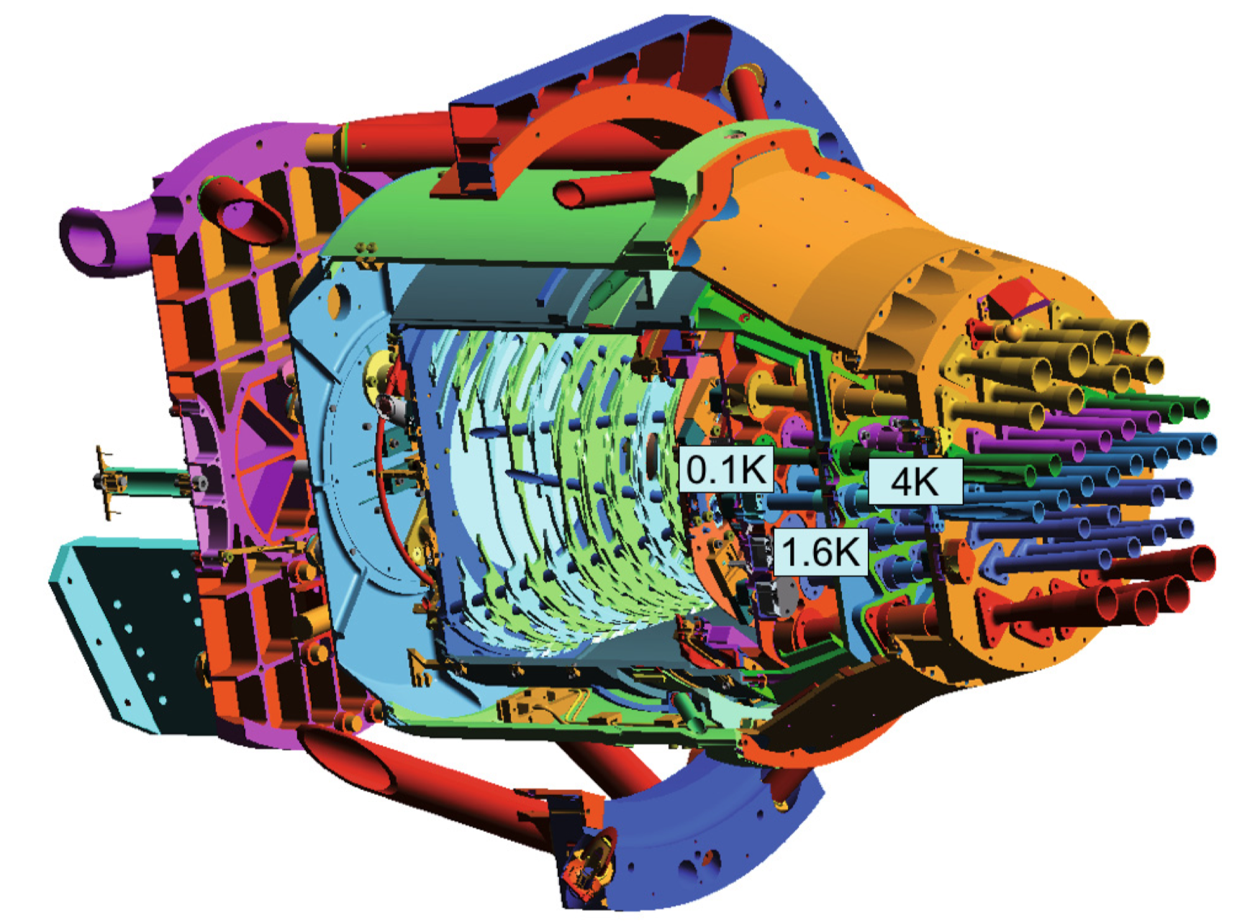
High Frequency Instrument
Lamarre et al. A&A 520, A9 (2010)

Slide 14
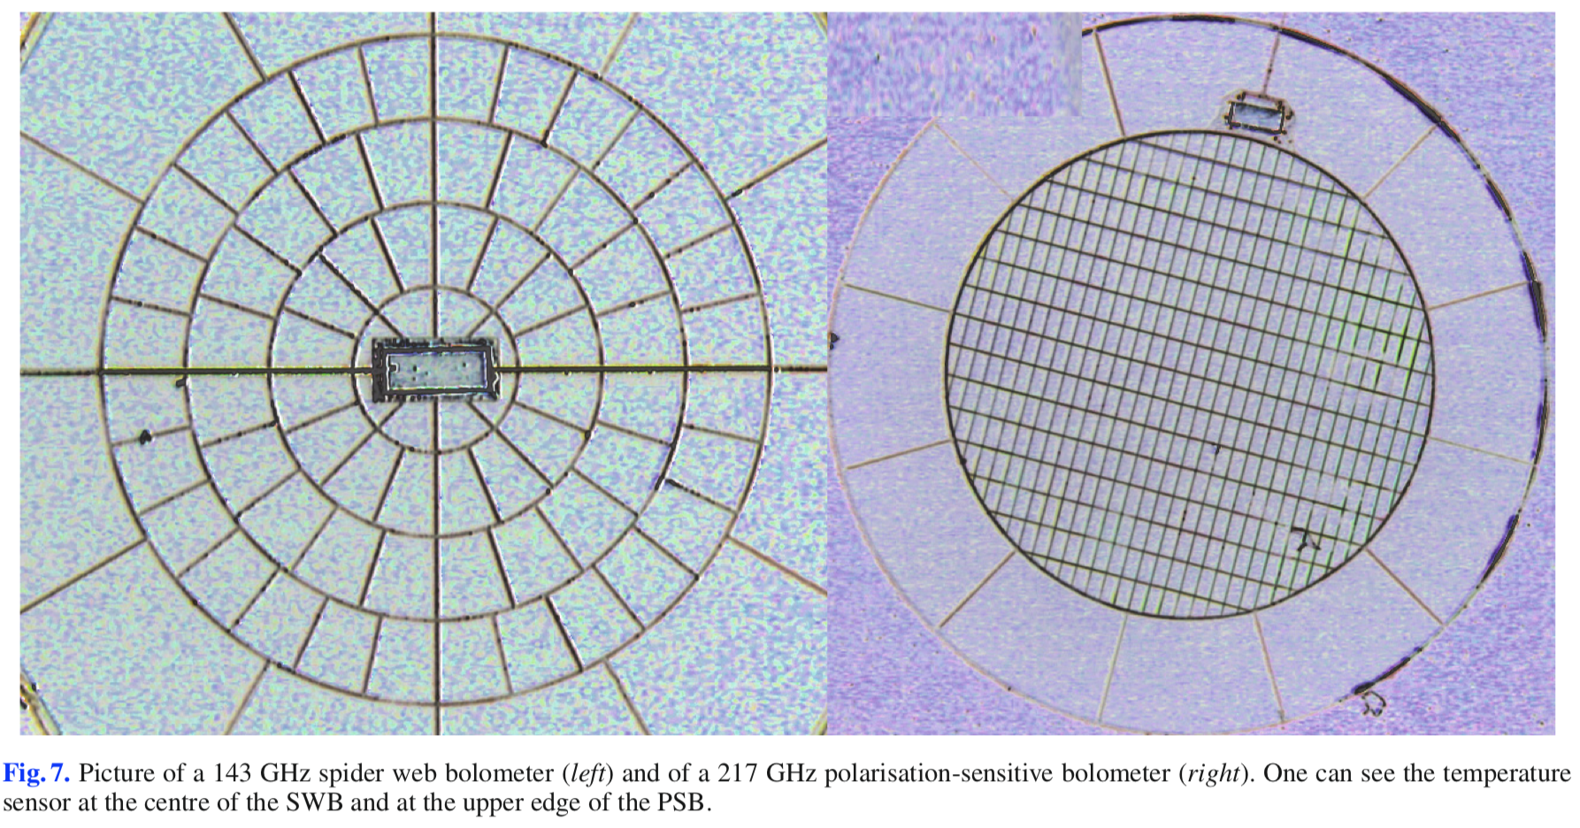
Bolometers
Lamarre et al. A&A 520, A9 (2010)
“Temperature sensor” = R(T). Nominal ~ 10 MΩ

Slide 15
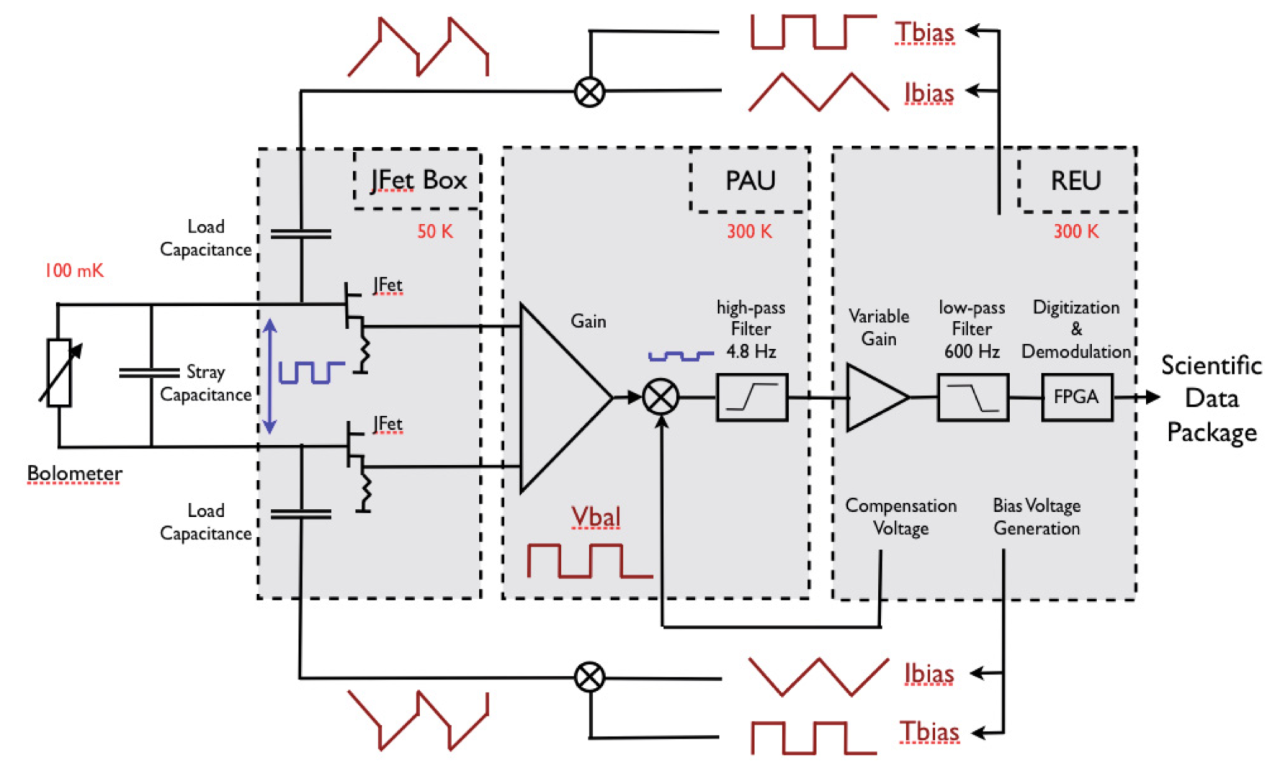
Readout
Lamarre et al. A&A 520, A9 (2010)

Slide 16
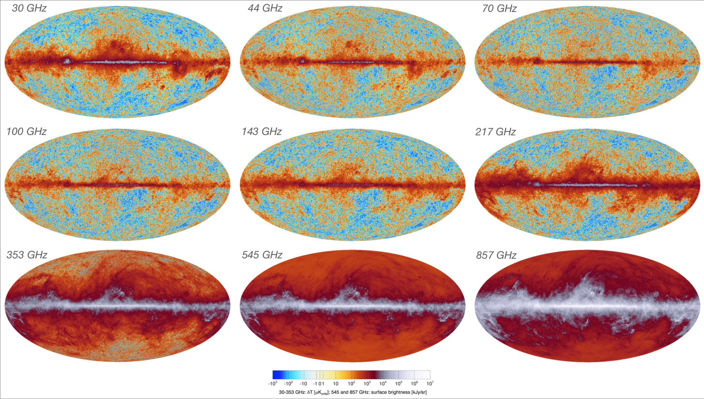
The Sky as seen by Planck (CMB + synchrotron, free-free, dust …)
Planck Image Gallery

Slide 17
Other Signals
Our Galaxy
Synchrotron radiation (relativistic electrons)
Free-free radiation (ionized gas)
Thermal dust (dominant at high frequencies)
Anomalous dust (rotational or magnetic dipole emission?)
Extragalactic
Active galactic nuclei (synchrotron sources – a few bright ones!)
Dusty star-forming galaxies (fluctuating background from z~few)
Sunyaev-Zel’dovich effect (hot gas in galaxy clusters)

Slide 18
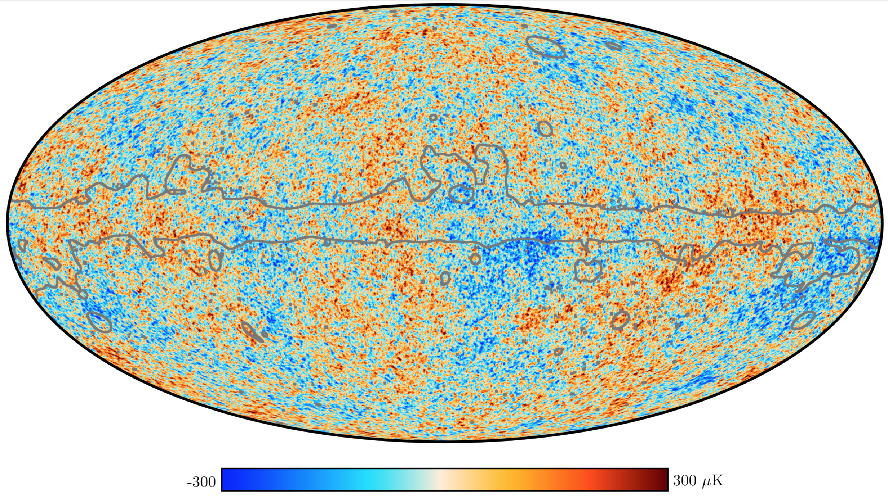
“Foreground Cleaned” (SMICA)
Planck Image Gallery

Slide 19
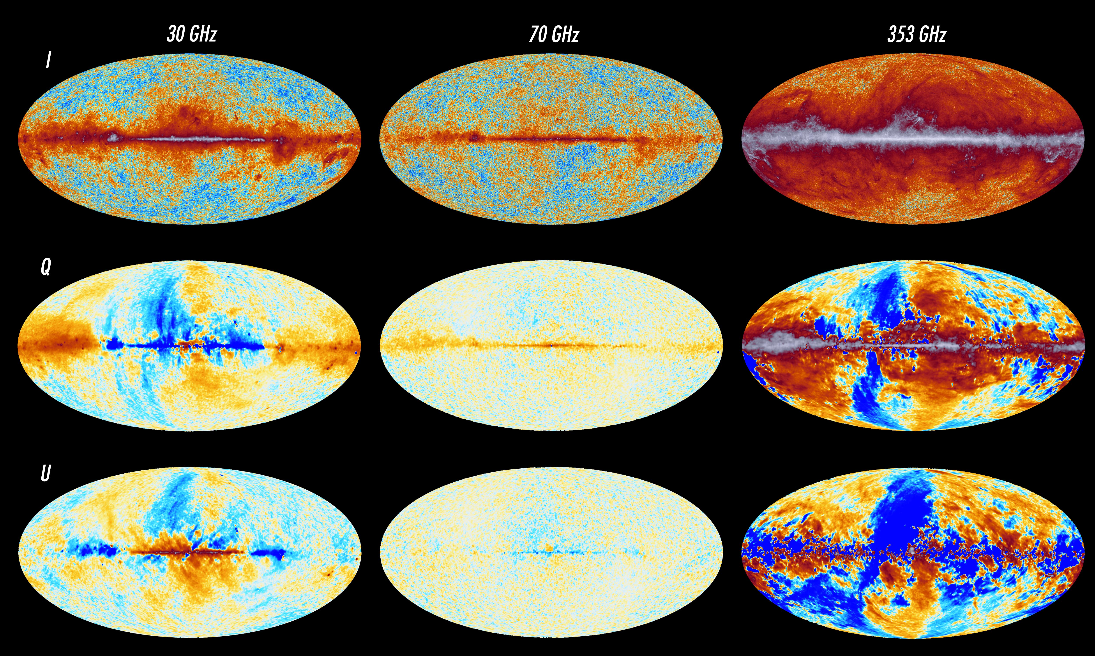
Planck Image Gallery

